Slide 1
Covering COVID Basics for Employers
Starkweather & Shepley Insurance Brokerage Inc.
Human Resources Risk Solutions
Florence DuPerry, Vice President

Slide 2
Our legal disclaimer…
Please be advised that this presentation is for informational purposes only. The information contained or made available is not intended to and does not constitute legal advice or recommendations under any circumstances.
S&S Human Resources Risk Solutions does not provide legal services.
Information provided as of November 2021.

Slide 3
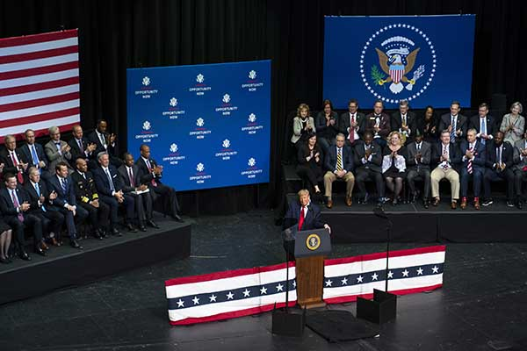
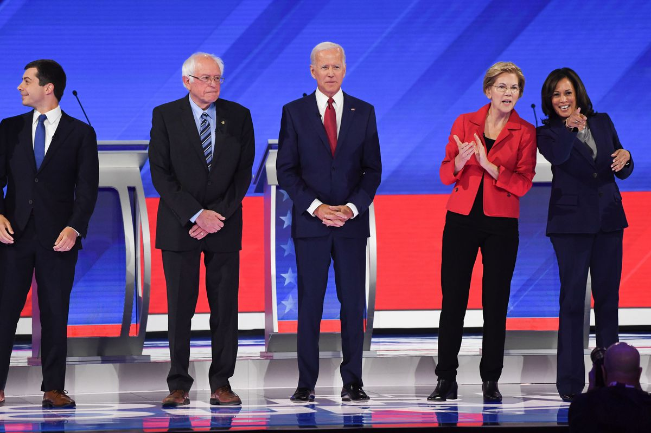
2020 started out like any other year… Thinking back…

Slide 4
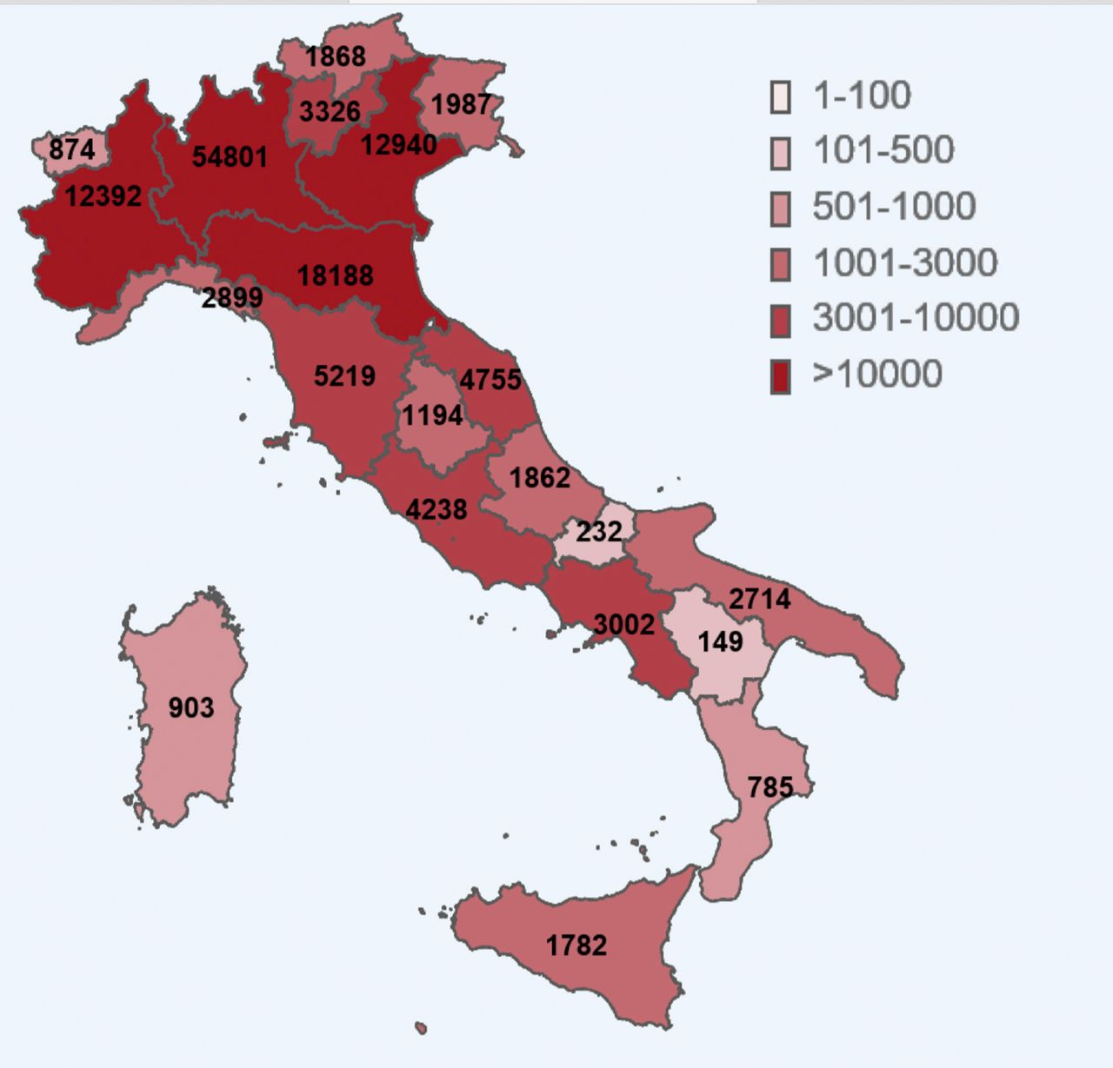
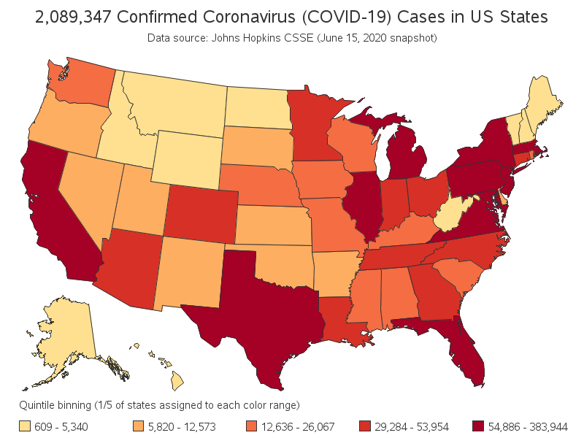
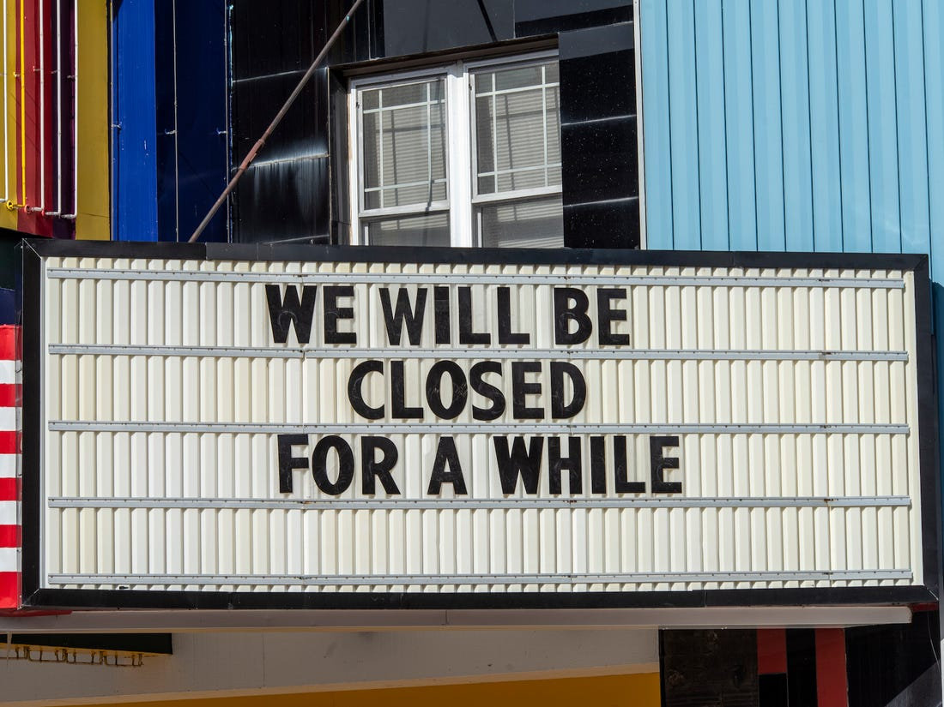
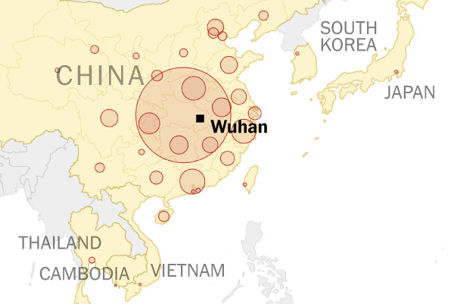
2020 Global Pandemic

Slide 5
And so, it continues in 2021…

Slide 6
What we will cover: COVID BASICS
Developing written COVID protocols for your organization
The need for written policies and protocols?
Complying with State Reporting and Posting requirements
Vaccination Mandates – OSHA ETS
Vaccination Mandates – Smaller Employers
Preparation prior to announcing your plan
What you need from your employees

Slide 7
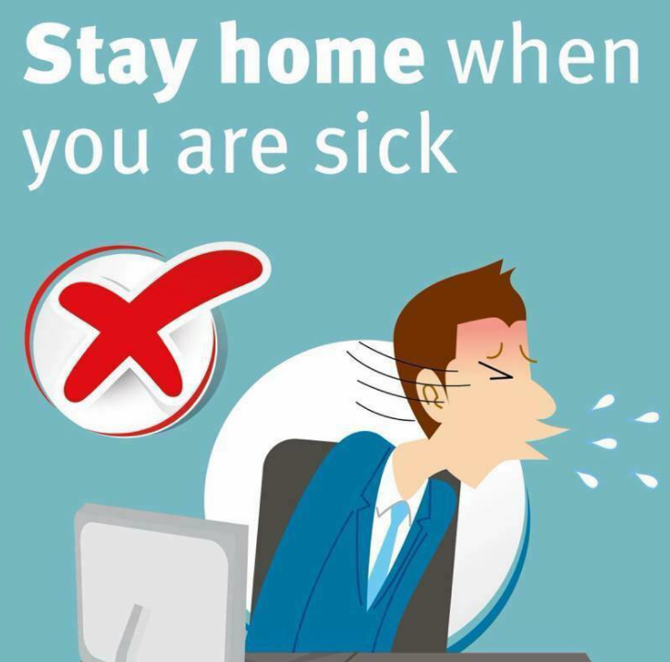
Develop Written Policies!
Draft written polices outlining:
Face mask requirement and usage policy
Social Distancing Policy
Sick Policy- remember to check your state laws to ensure your policy is compliant with COVID mandates.
Positive Case Policy- Outline what you will do if you learn you have a positive case on site.
Employee Communication and Training policy.
Employee and Visitor Screening policy

Slide 8
So much of this is common sense…Why develop written COVID policies and protocols?
To protect you, your employees, your clients and your business.
Provides you with a standard set of guidelines to follow.
Puts employees at ease, slightly.
To be in compliance with state and federal CDC guidelines
TO REDUCE YOUR RISK AS AN EMPLOYER

Slide 9
Comply with your State Requirements
know your state requirements – visit your Department of Health’s website.
Work collaboratively with them when requested.
Learn your state’s posting requirements:
COVID Screening posters
Face Mask Posters
Social Distancing Posters
Travel both domestic and international
Quarantine and Isolation requirements
Learn your state’s COVID plan requirements.

Slide 10
Vaccine Mandate – OSHA ETS
President Biden announced a national vaccine mandate on September 9, 2021, for employers with 100 or more employees. The Emergency Temporary Standard was released November 4, 2021.
What we know:
The ets applies to Employers with 100+ associates, locations not withstanding.
Employers must develop, implement, and enforce a mandatory vaccination policy.
Employers can choose to require vaccinations or adopt a policy requiring employees either to elect to get vaccinated or undergo regular covid-19 testing and wear a face covering at work.
Employees are required to provide proof of vaccination or must submit to weekly testing at their own expense.
Weekly testing for unvaccinated associates begins as of January 4, 2022.
All other aspects of the ETS go into effect December 5, 2021.
Masks required “indoors” (including at employees desks) for unvaccinated associates on December 5, 2021.
Religious and Medical exemptions can be requested.
LEGAL CHALLENGES EXPECTED!

Slide 11
Vaccine Mandate
What about smaller employers?
Yes, you can mandate vaccinations even if not covered under OHSA’s rule.
Asking for proof of vaccination is not a HIPAA violation.
Consider offering incentives.
Explain why you are mandating vaccinations– Employees are more likely to comply if they understand why.
Create and announce a timeline.
Announce consequences of non-compliance-treat like any other company policy.
Allow for Medical and Religious accommodations.
Apply your policy consistently.
What about clients or visitors?
You can require proof of vaccination for clients and visitors.
You can refuse entry with anyone who does not comply with your policy.

Slide 12
Preparation to Do prior to announcing your plan
Plan out how your company is going to track vaccinations and testing for employees.
There are Vaccination trackers on the market. Research and demo these tools.
Begin gathering data on who/how many employees are vaccinated. This information will support your tracking decisions.
Talk with your team about the issues now.
Review / Update policies (keep it in a pending state if necessary).
Solidify safety protocols regarding sensitive information.
Determine your reporting capability. Large employers (100+) will be required to report to OSHA in some form in the future. Begin preparations for this.

Slide 13
What you need from your employees
Patience
Flexibility
Consideration to your fellow employees
Open communication

Slide 14
Questions?

